Slide 1
Welcome to 7th Grade Social Studies and English
Mrs. Flaherty – English
mflaherty@yonkerspublicschools.org
Mrs. Oliveira – Social Studies
loliveira@yonkerspublicschools.org

Slide 2
Partners in Education
“At the end of the day, the most overwhelming key to a child’s success is the positive involvement of parents.”
-Jane D. Hull
We welcome your support and are looking forward to continuing our partnership in helping your children reach their goals!

Slide 3
Routines, Procedures & Policies
Work and Grading – Class work or homework is assigned daily. Students are responsible for submitting assignments on time unless there are extenuating circumstances or accommodations that have been communicated prior to the due date. Otherwise, no late work will be accepted.
Teams Expectations – Students are expected to sign in to their meetings on time, be respectful, take notes, pay attention and ask questions! We will work as hard as we can to make our meetings engaging.
Student Responsibility – Now more than ever, we are encouraging students to take initiative with their own learning. Please remind your children to reach out to us via chat or email with ANY questions they may have. Students are expected to keep track of their progress and grades via PowerSchool.

Slide 4
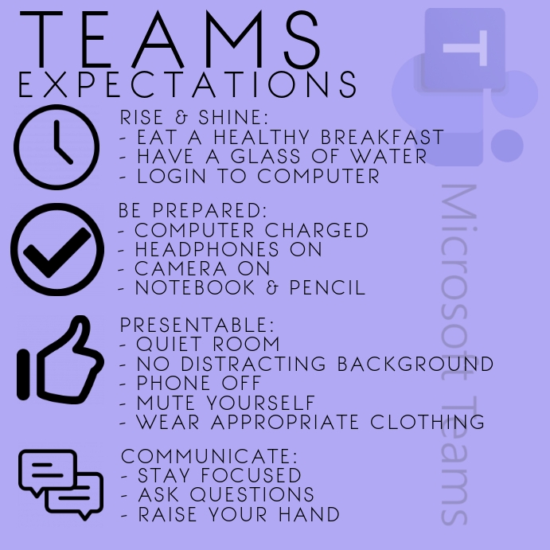

Slide 5
7th Grade English
The 7th grade English Language Arts curriculum focuses on themes of maturity, responsibility and identity.
Students will produce a writing portfolio through writing workshop including various writing samples, narratives, literary analysis, biographical sketches and creative writing pieces related to the literature studied.
Throughout the curriculum, students will be introduced to reading, writing and research skills that will prepare them for the 8th grade curriculum.
On their journey from 7th to 8th grade, students will develop their critical reading skills and their expressive writing techniques. The main focus of our literature study will be on the following topics:
What does it mean to be mature and responsible in our society?
How does one’s society affect their maturity, responsibility and growth?

Slide 6
7th Grade English
Grading Policy
tests, essays, projects
homework
classwork/quizzes
(total points; not weighted categories)
**Homework is not assigned every night; Any homework assignments assigned are necessary to either reinforce class work or prepare students for an upcoming topic.**

Slide 7
Literary Works
Short Stories
Poetry
A Long Walk to Water by Linda Sue Park
The Outsiders by S. E. Hinton
Refugee by Alan Gratz (time permitting)
Topic Study: Communication and Technology (nonfiction articles and resources)
Various selections and current events articles used for supplemental integration amongst units.

Slide 8
Writing Workshop
Writing genre is introduced through a modeled text and/or reading.
Through mini-lessons students are then taught writing skills that they will need in order to complete a Writing Workshop piece.
Students will then engage in the writing process utilizing their own timing and differentiated resources. Most, if not all, writing will occur in the classroom.
Mini-conferences between teacher and student and peer conferencing will be held throughout the duration of the Writing Workshop providing students with opportunities to “check-in” in regards to their writing.
I will grade each piece using a task specific rubric. The rubric will utilize criteria that was taught through the mini-lesson.
If I return a paper and a grade is less than a 90% the student are encouraged to revise, correct and improve their work.

Slide 9
7th Grade Social Studies
Curriculum and Skills
American History from early exploration through the Civil War.
Students will master critical thinking skills for interpreting maps, political cartoons and primary documents.
Prepare and participate in a range of discussions and collaborations to build upon others’ ideas and expressing their own clearly and persuasively.
Increase their ability to analyze information from a variety of sources.

Slide 10
7th Grade Social Studies Grading
Students are graded on a variety of criteria
Total point system
Each assignment is worth a certain amount of points depending upon the kind of assignment and how much time is given to complete it.

Slide 11
7th Grade Social Studies Grading
Homework - 10-20 points
Classwork- 10-20 points
Quizzes-5-30 points
Nearpod Participation 2-5 points

Slide 12
Technology: Communication and Instruction
Microsoft Teams (the app works best!) – interactive platform that allows for teachers to directly instruct, collaborate and provide class materials and assignments to students.
    Students will submit most of their work in their Assignments sections or in their Class Notebooks on Teams.
    Teachers will use the General Posts section to provide daily instructional agendas and objectives.
    Students can use the Chat feature to privately message their teachers regarding any issues they may have.
Remind – Parent, teacher and student app that allows for teachers to alert parents and students of upcoming assignments and events. Each class has their own section to join by code.
Microsoft 365 Outlook – student, teacher and administrator emails.

Slide 13
7th Grade Remind App Codes:
Please download the Remind app and use the codes to stay in contact:
@mflaherty7 — English
@jpiccoli7 -- math
@8b2fef4 -- science
@d89a94 -- social studies
@bcozzalih7 – health
@kellerpe7 – physical education

Slide 14
Technology: Apps for Content and Assessment
CLEVER – Website where students have a single sign-on to access all of the following apps and resources; students need to know their 6 digit ID number and password to sign in to Clever:
  Nearpod – Interactive instructional software that delivers lessons, videos, classwork and assessments.
  Quill – A grammar diagnostic app that gives students the opportunity to target and practice areas of writing weakness.
  CommonLit – A literacy app in which students are assigned readings where they must answer guided and comprehension questions.
  CASTLE – An online web-based instructional service that provides review and content in math, science, English and social studies.
  Quizizz – A gamified quiz app that allows students to review and also can give teachers the opportunity to test students’ content knowledge.
  BrainPop – An animated educational site for kids that gives students an introduction to content while testing their knowledge of what they have learned.

Slide 15
Reading and Writing Expectations Across the Curriculum
Annotating based on genre (fiction vs. nonfiction).
Critical evaluation of texts and synthesizing information amongst sources.
Analyzing for presence and use of literary devices, sequencing, author’s purpose and point of view, and development of ideas.
Analyzing the relationship between primary and secondary sources of the same topic

Slide 16
Reading and Writing Across the Curriculum
Distinguish among fact, opinion and reasoned judgment in a text
Writing cohesive TSC paragraphs that address a prompt or question with relevant, text-based evidence.
Planning and writing extended responses (essays) based on a common Written Response Rubric. Extended responses should prove a thesis and be fully-developed with text based evidence used in support of a claim.

